Slide 1

Analysis of Cryptography Algorithms for Data Security on Cloud
Supervised By:
Dr. Boshir Ahmed
Professor
Department of CSE
Presented By:
Md. Shahriar Mahmud
Roll No: 143113
Department of CSE

Slide 2


Index
Objectives.
Motivations
Literature Review
Background Studies
Proposed Methodology
Implementation
Result
Limitation
Conclusion
Future Work
Bibliography

Slide 3
Objectives
1
Add an extra layer of security for sensitive data on Cloud.
2
Develop a model for this purpose.
3
Compare Efficiency(Memory, Time) of cryptography algorithm( AES, DES, Blowfish)
Notes:
https://digitalguardian.com/blog/6-security-risks-enterprises-using-cloud-storage-and-file-sharing-apps
NO CONTROL OVER DATA
DATA LEAKAGE
BYOD
SNOOPING
KEY MANAGEMENT
CLOUD CREDENTIALS

Slide 4

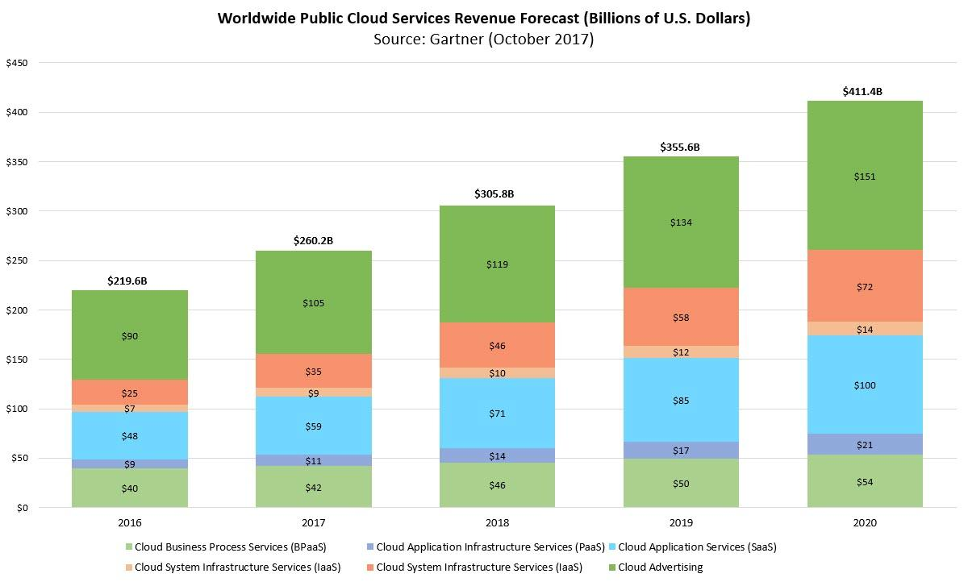
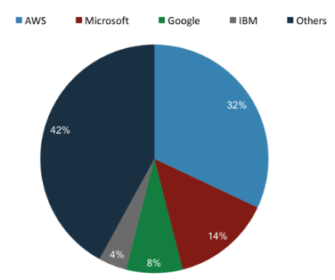
Motivations
Fig i: CSP Market Occupied
Fig ii: Cloud Market by Forbes

Slide 5
Motivations(Cont’d)
Massive amount of data are not stored on Cloud for lack of trust^{[11]}.
Data are often stolen and analyzed from server^{[11].}
Feeling unsafe of storing sensitive data in Cloud.
In this proposed model, No need to trust Cloud Service Provider.

Slide 6
Literature Review
An Approach towards Data Security in the Cloud Computing Using AES[1]
Describes AES Encryption Algorithm.
Illustrate AES by using CloudSim.
Configure Resistivity against Attacks.
Do not have any Description for other Encryption Algorithm
.
Secure Data Access in Cloud Computing[4]
Cloud market overview.
Describes D-H key exchange protocol.
Secure data access policy between CSP and User Using D-H key exchange.
Theoretical Implementation of D-H key Exchange .
Whole process is theoretical and algorithm based.
Do not Simulated or Implemented.

Slide 7

Background Study
Security Issues in Privacy Preserving and Data Security in Cloud Services^{[1]}.
Data Security and Privacy Protection Issues in Cloud Computing^{[6][2]}.
Secure Data Access in Cloud Computing ^{[4]}.
Cryptography Algorithms^{[7]}.
Socket Programming.

Slide 8


Proposed Methodology
Digital Certification
Decryption
Data Server
(Encrypted Data)
Requested
Send
Or
Received
Key
Message
Encryption
Client Side
Fig iii: Client Server Secure Data Exchange

Slide 9



Client
Implementation
Server
Socket
Connect
Set Socket
Send
Bind
Listen
Accept
Message
Encrypt
Received
Storage
Key
Decrypt
Requested
Fig iv: Implementation by Socket Programming

Slide 10
Result
Memory Allocation
Table i: Memory allocation
Plaintext Size (Bytes) | DES | Blowfish | AES
 | Ciphertext Size (Bytes) | Ciphertext Size (Bytes) | Ciphertext Size (Bytes)
256 | 352 | 352 | 364
512 | 969 | 969 | 706
1024 | 1376 | 1376 | 1388
2048 | 2744 | 2744 | 2752
4096 | 5472 | 5472 | 5484
8192 | 8192 | 8192 | 10944
18496 | 24672 | 24672 | 24684

Slide 11
Result
Key Generation
Table ii: Key Generation
Plaintext Size (Bytes) | DES | Blowfish | AES
 | Key Generation(ns) | Key Generation(ns) | Key Generation(ns)
256 | 4191755366 | 3959998300 | 4084432166
512 | 4012703999 | 4315550300 | 4021682333
1024 | 4159378433 | 3960104300 | 3994030366
2048 | 4150029067 | 4251588100 | 4150138467
4096 | 4194212933 | 3860427500 | 4191800800
8192 | 4091672966 | 3913238200 | 4167250066
18496 | 3371296200 | 3396035300 | 3469053500

Slide 12
Result
Encryption Time
Table: Encryption Time
Plaintext Size (Bytes) | DES | Blowfish | AES
 | Encryption Time (ns) | Encryption Time (ns) | Encryption Time (ns)
256 | 13308933 | 14201300 | 12152866
512 | 14403067 | 14388367 | 11096300
1024 | 12999999 | 15407800 | 10800766
2048 | 15960566 | 16842766 | 13809299
4096 | 15995367 | 14877133 | 12432600
8192 | 17221466 | 17684600 | 13441966
18496 | 20231300 | 19077400 | 19252500

Slide 13
Result
Decryption Time
Table iii: Decryption Time
Plaintext Size (Bytes) | DES | Blowfish | AES
 | Decryption Time (ns) | Decryption Time (ns) | Decryption Time (ns)
256 | 603967 | 588133 | 319800
512 | 883866 | 503199 | 382233
1024 | 1214066 | 600600 | 632500
2048 | 1294033 | 848500 | 1270100
4096 | 1117600 | 1017333 | 1692733
8192 | 1802433 | 1546866 | 2466699
18496 | 4969400 | 2540600 | 8839600

Slide 14
Result
Total Time
Table iv: Time without Key Generation
Plaintext Size (Bytes) | DES | Blowfish | AES
 | Total Time (ns) | Total Time (ns) | Total Time (ns)
256 | ‭13912900‬ | ‭14789433‬ | ‭12472666‬
512 | ‭15286933‬ | ‭14891566‬ | ‭11478533‬
1024 | ‭14214065‬ | ‭16008400‬ | ‭11433266‬
2048 | ‭17254599‬ | ‭17691266‬ | ‭15079399‬
4096 | ‭17112967‬ | ‭15894466‬ | ‭14125333‬
8192 | ‭17797800‬ | ‭19231466‬ | ‭15908665‬
18496 | ‭25200700‬ | ‭21618000‬ | ‭28092100‬

Slide 15
Result
Total Time
Table v: Total Time
Plaintext Size (Bytes) | DES | Blowfish | AES
 | Total Time (ns) | Total Time (ns) | Total Time (ns)
256 | 3872334933 | 4380443200 | 4096904833
512 | 4027990933 | 4144691000 | 4033160866
1024 | 4173592500 | 4041796100 | 4005463633
2048 | 4167283667 | 4138455933 | 4166011200
4096 | 4211325900 | 4048983066 | 4205926133
8192 | 4110696866 | 4006725300 | 4183158732
18496 | ‭3396496900‬ | ‭3414924500‬ | ‭3497145600‬

Slide 16



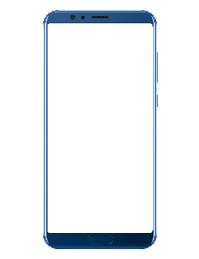

Limitations
Key Distributer
Device 1
No Data
Risk
Single User With Multiple Device
Data Server
No key
Device 2
Fig: Limitation of Proposed Model
Device 3

Slide 17
Conclusions
Truly 100% security over internet is rarely Possible
This model allows control over data only by its owner.
In developing solutions to cloud computing security issues it may be helpful to identify the problems and approaches in terms of
Loss of control
Lack of trust

Slide 18


Future Work
Key Policy Can be improved.
The resultant outcome requires to test on multiple device.
Need to test on practical field to analyze its effectiveness.

Slide 19
Bibliography
D. Chen and H. Zhao, “Data Security and Privacy Protection Issues in Cloud Computing,” in 2012 International Conference on Computer Science and Electronics Engineering (ICCSEE), 2012, vol. 1, pp. 647– 651.
Z. Xiao and Y. Xiao, “Security and Privacy in Cloud Computing,” IEEE Communications Surveys Tutorials, vol. 15, no. 2, pp. 843–859, 2013
Santosh Kumar Singh, Dr. P.K. Manjhi, Dr. R.K.Tiwari, ” An Approach towards Data Security in the Cloud Computing Using AES”,in June 2016 International Journal of Advanced Research in Computer and Communication Engineering , Vol. 5, Issue 6, pp. 22-29
Sanka S, Hota C, Rajarajan M (2010) ,”Secure data access in cloud computing”, In: IEEE 4th international conference on Internet multimedia services architecture and application (IMSAA), pp 1–6
Arun Nagraza, N Mangathayaru ; N Rajashekar ,” Privacy preserving and data security — A survey ”in: 2016 International Conference on Engineering & MIS (ICEMIS).
Shaikh Ashapakh Sattar, “ Security Issues in Cloud Services”, in June 2016 International Journal of New Technology and Research Vol.2, Issue-6,pp.08-10.

Slide 20
Bibliography (Cont’d)
Bih-Hwang Lee, Muhammad Farid Wajdi, Ervin Kusuma Dewi; ,” Data security in cloud computing using AES under HEROKU cloud”, 2018 27th Wireless and Optical Communication Conference (WOCC) On: IEEE
The NIST Definition of Cloud Computing Recommendations of the National Institute of Standards and Technology.Special Publication 800-145.
Khadijah bahwairteth, Mohammad A,” Experimental comparison of simulation tools for efficient cloud and mobile cloud computing applications” 14 June 2016 by EURASIP Journal on Information Security
Stephanie Condon ,”Security concerns haven't stopped the vast majority of organizations from storing sensitive data in the public cloud” , April 16, 2018 by McAfee survey.

Slide 21
THANK YOU
END OF SLIDE

